Slide 1
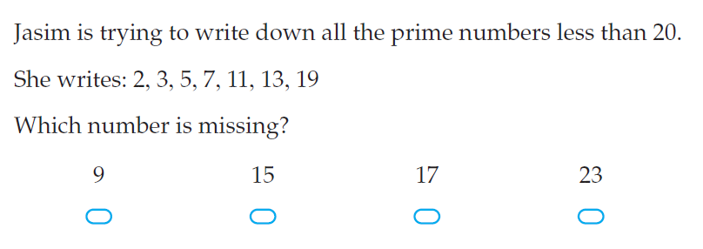
5 questions
Find the mean and median of 9, 10, 8, 10, 11
If three sides of a triangle measured 5cm, 8 cm, 10 cm. What name can we give it?
Draw a corresponding angle to the one shown
Write three numbers where the mode is 5: ____ ____ ____
.

Slide 2
5 , 8 , 10, 10, 8, 3, 7, 11
LHS
Mean –
Median –
Mode -
Range -

Slide 3
Mean = 6

Slide 4
Range = 5

Slide 5
mode = 10 & 3

Slide 6
mean = 5

Slide 7
COMPLETE THE WORKSHEET
(in partners)

